Slide 1
Instruction Cycle
The program is executed in the computer by going through a cycle for each instruction. Each instruction cycle in turn is subdivided into a sequence of sub-cycles or phases. In the basic computer each instruction cycle consists of the following phases
1. Fetch an instruction from memory.
2. Decode the instruction.
3. Read the effective address from memory if the instruction has an indirect address.
4. Execute the instruction
Upon the completion of step 4, the control goes back to step 1 to fetch, decode, and execute the next instruction. This process continues indefinitely unless a HALT instruction is encountered.

Slide 2
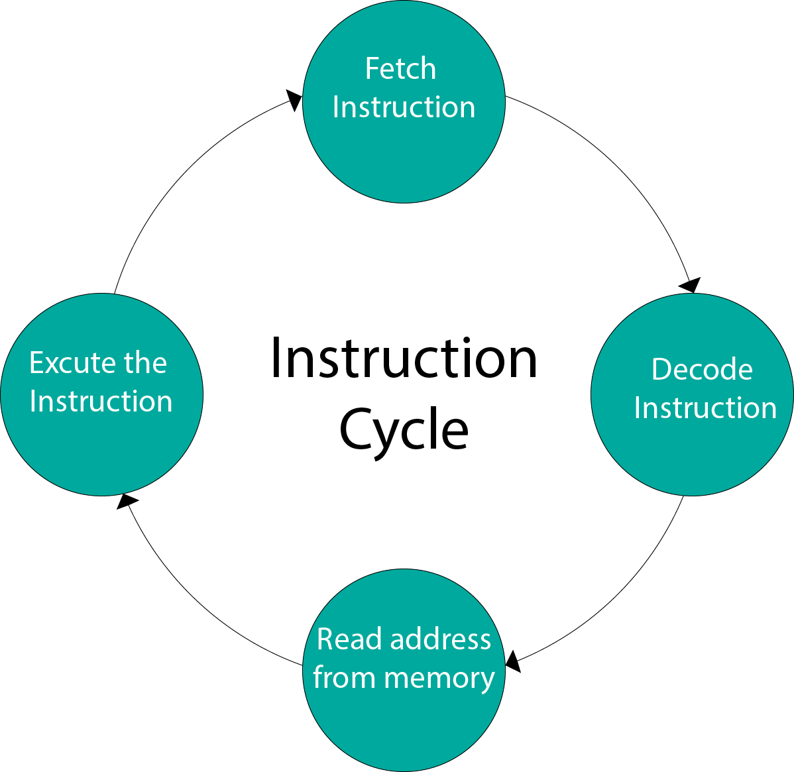

Slide 3
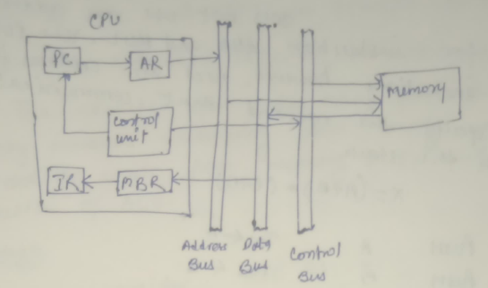
Fetch and Decode Sub-cycle

Slide 4

During the fetch phase, an instruction is fetch from memory.
1. Initially the PC contains the address of the next instruction to be fetched.
2. Since only AR is connected to the address bus of memory, it is necessary to transfer the address from PC to AR during the clock transition associated with timing signal T0
3. The control unit read instruction from memory is then placed in the instruction to data bus and copied into MBR and the move to register IR with the clock transition associated with timing signal T1• At the same time, PC is incremented by one to prepare it for the address of the next instruction in the program
i.e.
At time T2, the operation code in IR is decoded, the indirect bit is transferred to flip-flop I, and the address part of the instruction is transferred to AR .
T2:
The execution cycle takes many forms. This cycle may includes transferring data among registers read or write from memory or I/O and the action of ALU

